Slide 1

House Prices - Advanced Regression Technique
House Prices - Advanced Regression Techniques
He Wei, Yiqi Wei, Tracy Cheng

Slide 2
Team members!
Tracy Cheng
Yiqi Wei
He Wei

Slide 3
Project information
Goal:
Build a model that predicts housing prices
Data sets:
Ames Housing dataset
King County Housing dataset
Skills:
Creative feature engineering
Linear Regression, Lasso Regression, Elastic Regression
Transfer learning!!

Slide 4
Data
Ames Housing dataset - https://www.kaggle.com/c/house-prices-advanced-regression-techniques
King County Housing dataset (Seattle) - https://www.kaggle.com/harlfoxem/housesalesprediction

Slide 5
Features
Ames
1460 rows
80 columns
37 of them are numerical
43 of them are categorical
Most of them were related to a specific trait of the house
King County
21613 rows
20 columns
15 of them are numerical
5 of them are categorical
Most of them were general data

Slide 6
Numerical data (Ames)
17 columns are discrete values such as: Number of Fireplaces, bathrooms, floors, Month sold, etc.
16 columns are continuous values include square footage, lot area, etc.
4 columns are Year values (time is sort of unique here, so we separated them from the other values)

Slide 7
Categorical data (Ames)
43 columns (Lot shape, Zoning, Utilities, Neighborhood, etc)

Slide 8
Numerical data (King County)
4 columns are discrete values such as: Number bathrooms, floors, id, etc.
8 columns are continuous values include square footage, lot area, etc.
3 columns are date values

Slide 9
Categorical data (King County)
5 columns (View, Grade, Condition, etc.)

Slide 10
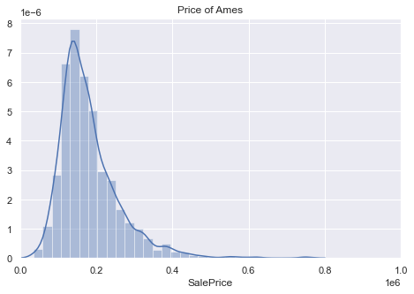
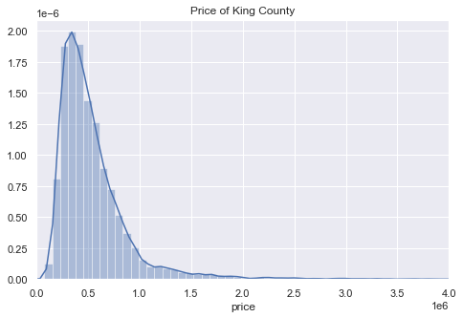
Price Distribution: Ames vs King County

Slide 11
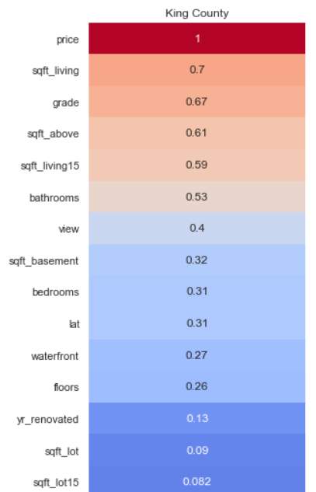
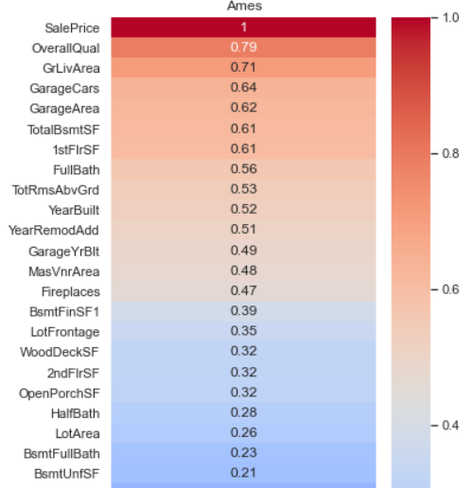
Most related Column: Building Quality & Living Size

Slide 12
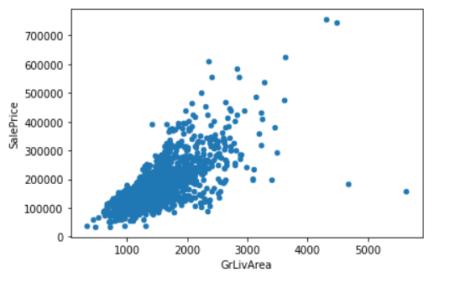
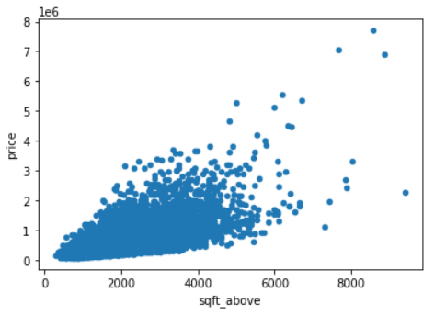
Relation Between Price and Living Size
Ames King County

Slide 13
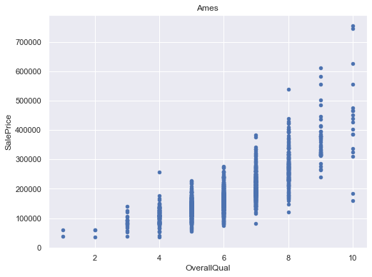
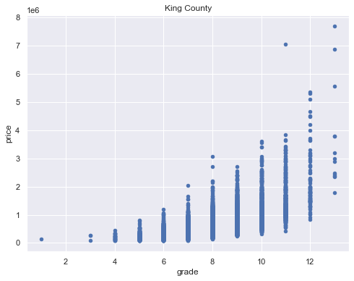
Relation Between Price and Building Quality

Slide 14
Related columns in Ames and King County data
Columns
Living Size
Building Quailty
Bathrooms
House Prices
King County
Sqft_living
Grade
Bathrooms
Price
Ames
GrLivArea + TotalBsmtSF
OverallQual
FullBath + HalfBath + BsmtHalfBath + BsmtFullBath
SalePrice

Slide 15
Data Engineering
Grouping numerical data (bedrooms, bathrooms, Sqft of space)
Combine similar columns between the two datasets

Slide 16
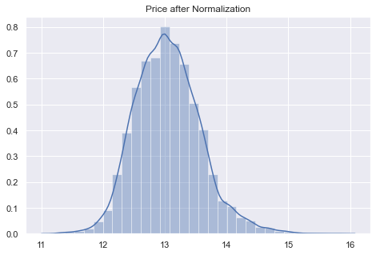
Data Normalization
Before
After

Slide 17
Add Region Trait columns
House prices per living size
House prices per lot size
Median house price per living size
Median house price per lot size

Slide 18
Models
Used in the past on Ames data:
Linear Regression
Linear Regression + Lasso
Ensemble Model combining Linear Regression, Random Forest, and XGB Boost
What we wanted to explore:
(Ames Linear regression model + target city median $/sqft + target city columns) → predict housing price of a property in target city

Slide 19
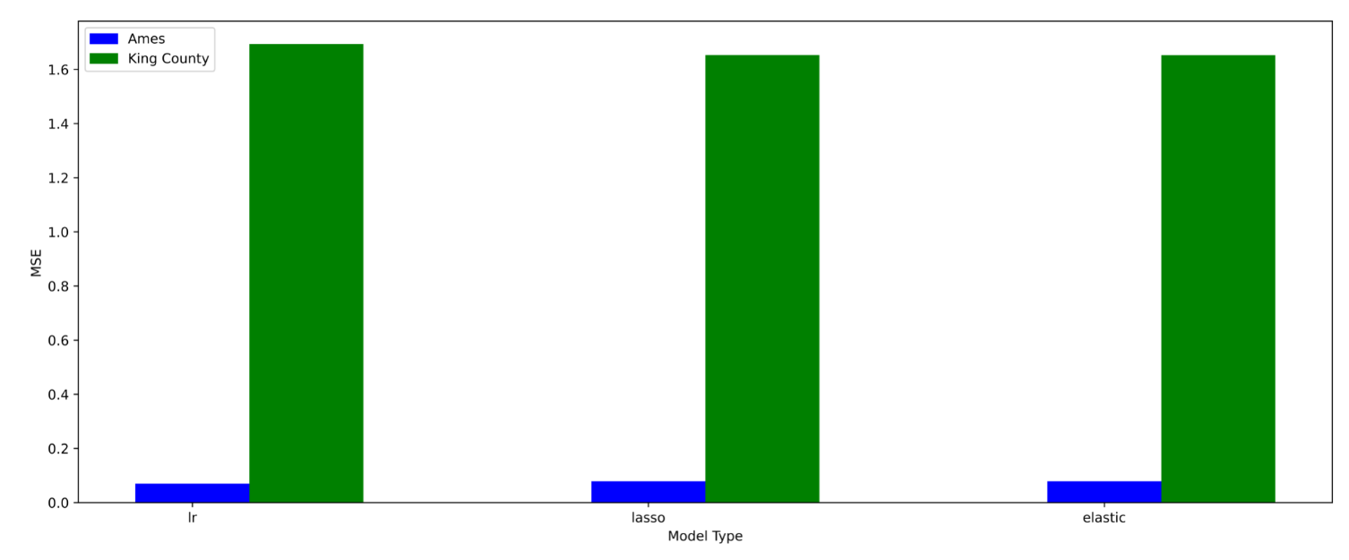
Results

Slide 20
Why?
Area (King County: 2,307 mi² vs Ames: 27.68 mi²)
Population (2.253 million vs 66,023)*
Distribution
Median values for a large area are less valuable when there is significant clustering/variance
*2019 data

Slide 21
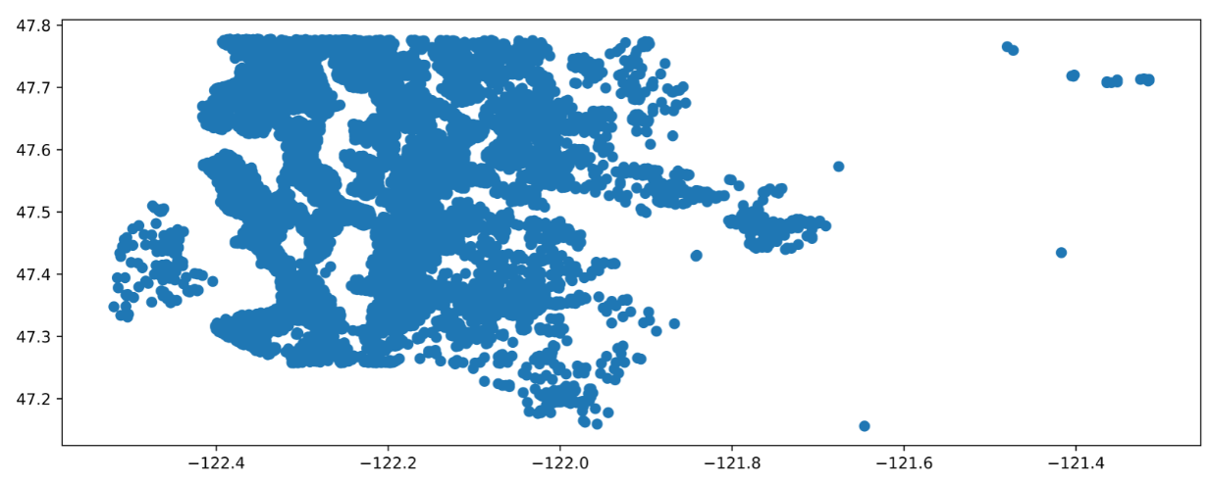
Distribution (King County)

Slide 22
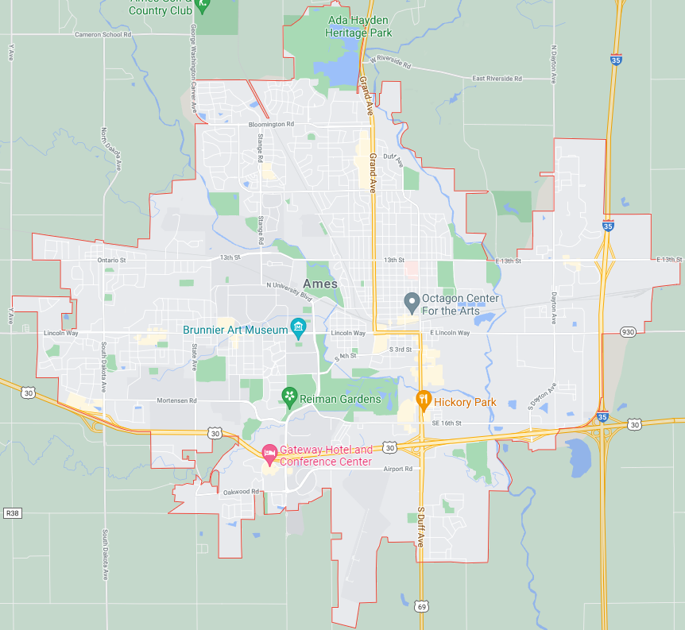
Ames

Slide 23
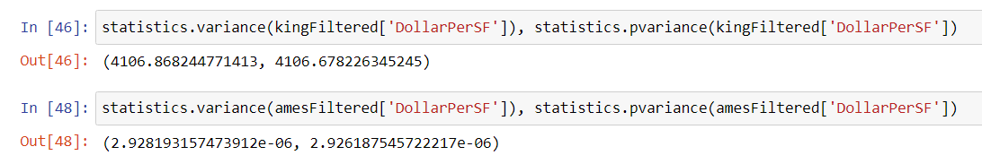
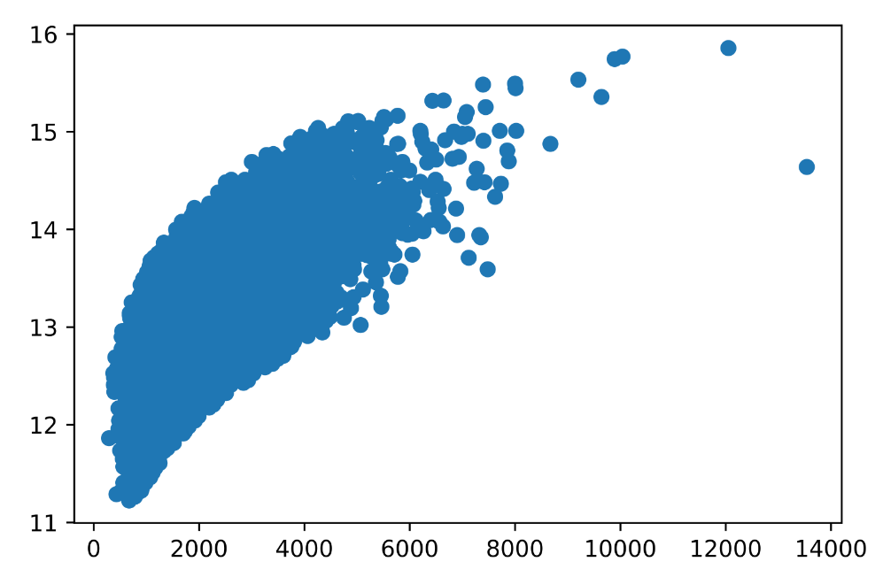
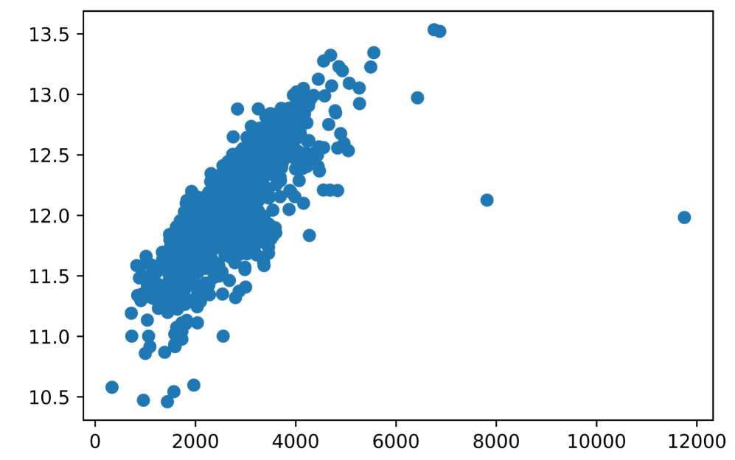
Variance comparison
King County
Ames

Slide 24
Conclusion
Liveable sq ft is king
Ames data is comparatively more homogenous than the King County data

Slide 25
Future Work
Add a model to ID clusters of sale prices / city neighborhoods to more accurately find median price per sqft for each row
Improve base Linear Regression model by implementing an ensemble or some other model

Slide 26
Questions?

